Slide 1
MSSP, MFA, MDR…
So Why Isn’t
Incident Response
Solved?
03/12/2024 / (v1.0)
Prepared For: B-Sides London ‘24

Slide 2

Intro’s & Overview:
#WhoAmI:
TimH: Director – Cyber Services
In the wrong place, at the right time, since 1999
Hacking things since 1989*
CISO, Deputy CISO, Head of Security Architecture, Ops & Engineering, Head of Cyber, AppSec / DevSecOps Lead, IR, Post Breach Advisory, Security Training, Security Product Owner, Architect, Consultant
Banking, Insurance, Health Digital, HMG Nuclear, Fire & Rescue, Luxury Retail, National Charities, Telco, Pharma…
Lucky to have worked with or trained with a bunch of people here today (Yay!)
Tim's spend so long battling imposter syndrome and looking for the grown-up in the room only to have the terrible realisation, it's him again over and over;
Tim’s dealt with APT attacks in FS and Lux Retail, Large scale crypto malware attacks, covert forensics for law enforcement, incidents in [REDACTED], Telco and other breaches with TV coverage etc to the point some clients have asked - is it you, are you just that unlucky :D
Hat Tip to Co-Creator Maj. Chris Wilkinson who can’t be here today but was instrumental in creating
https://www.linkedin.com/in/tsdhaynes/
*Legally, with permission
DISCLAIMER:
This is a composite of incidents and organisations across that experience, not any one incident or organisation.

Slide 3
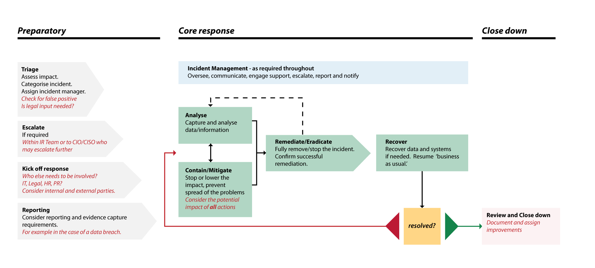

Incident Management Vs Incident Response
Src: NCSC 10 Steps Incident Response Guidance
Notes:
This picture is business friendly and feature complete, but the Prep and Close Down sides tend not to be wholistic, especially the learning loop. Personally prefer SANS PICERL but this is more board friendly.

Slide 4
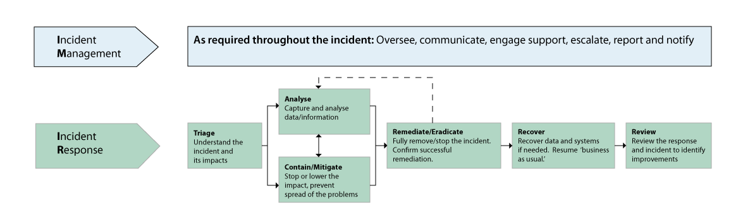
Zoom In
Src: NCSC 10 Steps Incident Response Guidance
Notes:
Zooming in to the core bit – IM – the management, Gold / Silver level stuff.
IR – The hands on / technical / operational – Bronze level stuff

Slide 5

The Problem Space
Src: NCSC 10 Steps Incident Response Guidance
Notes:
What if IM and IR are split across organisations, e.g.
Customer org | MSSP
HQ and Franchises
Group + Subsidiaries
Countries?

Slide 6

Business & Enterprise Architecture Context
EA has to take a top-down, Duplo block sized approach to understanding and shaping the organisation.
It would be too complex to get into the detail of everything, so abstraction from Lego to Duplo sized chunks is used by both Business Architects and Enterprise Architects.
Unfortunately the on-the-ground realities of IM and IR don’t necessarily fit the big-block view as we’ll show, and the level of abstraction applied can get in the way, e.g.
Is <Capability X> a Data Quality or Security Detection Control?
Totally necessary for an orderly taxonomy and progress at enterprise scale.
Doesn’t necessarily help on the ground where a threat actor doesn’t follow a model.
Img: Stackexchange
Notes:
This isn’t knocking EA’s, you cannot look at an enterprise in macro focus and keep it all in your head. They also hear when making change that everyone’s an exception. Definitely beneficial to get them exposed to some of the operational challenges, including getting your ESA’s involved in exercising or responding to see whether their vision for the city works for builders, operators, defenders…

Slide 7
How did we get here? (1/3)
Historically, there were a range of disciplines feeding into
Incident Response (Hands-On, Technical)
Incident Management (Big Picture, Management).
While they were separate disciplines, they were within the same organisational entity and so had:
At least some degree of shared business context and culture
Management structures
Ad-hoc, relationship based networks within corporate boundaries
IR
IM
SecOps
GRC
Sysadmin
Technical
Architecture
Service Delivery
BRM
Architecture
Resilience
Op Risk
Networks
Infrastructure
Helpdesk / ServiceDesk
Organisational Boundary
Notes:
Slightly simplistic but usable. Note that this will likely get worse as skills focus on the midpoint down not covered well at all at Schools, colleges, university and there’s a personal pivot from hack to consume.

Slide 8

How did we get here? (2/3)
Some organisations attempted to sustain their IR and technical security capabilities in-house.
Without feeder streams from areas that are now with the OSP, this becomes increasingly difficult to resource and sustain.
ITSEC
IM
IR
Security
Management
Sysadmin
Technical
Architecture
IT Outsource
Service Provider
Service Delivery
BRM
Architecture
GRC
Networks
Infrastructure
Resilience
Op Risk
Organisational Boundary
Helpdesk
Notes:
Once the ITSP is outsourced, the feeder stream is gone. There are also contractually binding commitments and if the contract hasn’t been set up with security-specific SLA’s security and the ITSP may have opposing goals (uptime, containment) although that’s another talk.

Slide 9
How did we get here? (3/3)
The logical step was a Business Process Outsource of the Technical, Operational Security functions, in most cases to a specialist Managed Security Service Provider.
What was previously one organic entity, with feeds and exchanges on an ad-hoc, relationship basis, is now three discreet entities, with commercial boundaries.
Crossing organisational boundaries is one thing, commercial boundaries is much harder.
At this stage it posses challenges for both the IR capability and the IM Capability
MSSP
IR
IM
Security
Management
Sysadmin
Technical
Architecture
GRC
IT Outsource
Service Provider
Service Delivery
BRM
Architecture
Networks
Infrastructure
Resilience
Op Risk
Organisational Boundary
Commercial Boundary
Helpdesk
Notes:
At the endpoint here the organisational knowledge to run SIEM, SOC, xDR is out of the door, and the business knowledge is highly fractional. Commercial boundaries and hand-offs are everywhere and there may be no way to access experience or training that would help retained Security Management make sense. This introduces horrible impacts on psychological safety if they are under-empowered or resourced.

Slide 10
Wicked Problem:
MSSP
Security Management is receiving technical information and containment, eradication and recovery decisions from the MSSP’s IR team without a background in the technical aspects or practicalities of adversarial incidents..
Security Management is functioning as “air traffic control, sometimes via Service Delivery, to manage the It Outsource Service Providers actions. The OSP may have uptime driven primary SLAs and be reluctant to cause downtime.
Security Management has to translate inputs and decisions from both MSSP and ITOSP to their
business
IR
MSSP Teams will not be aware of
Organisational context, informal networks, tacit knowledge and may be only receiving selective logs and information from the IT OSP.
They may also be struggling
with the customer teams
not having insight or
Appreciation into how
much effort goes into
investigating huge
volumes of alerts
IM
Security
Management
IT Outsource
Service Provider
Sysadmin
Technical
Architecture
Service Delivery
BRM
Architecture
GRC
Organisational Boundary
Networks
Infrastructure
Resilience
Op Risk
Commercial Boundary
Helpdesk
Notes:
Compsci Courses – many don’t have security, or if they do it’s GRC only. GRC is the glue that keeps the security world together, but how often have you seen an Incident Policy without an Incident Plan you could execute technically?
Security By Design /Default – does it include ops, IR? – if not it’s probably Design only :/
ScenarioL Cloud, App, API, AI Digital Transformation, EA checklist says there’s SIEM, SOC, IR but its an Infra Centric MSSP agreement / the DevOps teams aren’t in the loop for response.
CISO heritage can make a big difference here – they may never have been offered the training and experience that would let them identify this as a problem.

Slide 11
We have a possible detection we’d like to hash-ban in EDR as a precaution. Please can you authorise.
I’m not sure what that means.
Sounds like it could cause disruption, I could get it in the neck from the IT OSP and our business.
Play safe, say no
MSSP
IR
IM
Bob in accounts account is behaving strangely. Can you fix it?
[Subtext: Bob’s now deputising for the CFO using the CFO’s BizSaaS Credentials]
Who’s Bob in Accounts?
They’re not FinAdmin or SysAdmin… [Ticket:=Sev5]
Security
Management
BizSaaS is being weird, a lot of stuff seems to be being shared then disappearing…
BizSaaS – that hasn’t been onboarded so we can’t help I’m afraid.
Sysadmin
Technical
Architecture
Biz SaaS
IT Outsource
Service Provider
Service Delivery
BRM
Architecture
GRC
Networks
Infrastructure
Resilience
Op Risk
Organisational Boundary
Commercial Boundary
Helpdesk
Notes:
No P1,2,3 – Not onboarded at the MSSP, Helpdesk but running. Or mechanistic scoring where we can’t hit >P3 but this or the business assets beyond it are serious?
Do the MSSP have the data flows, designs, threat models, or just the raw data? Has their feed already been aggregated / concentrated to the point contextual data is lost?
“MSSP / MDR / MFA project is complete” – If BAU doesn’t have the capability to keep up with ongoing change, this starts fading from the day of the project close down.

Slide 12

Two Way Dissatisfaction
IR
IM
MSSP
Result – MSSPs:
Reduction in psychological safety
Feeling of not being part of shared mission
Analyst burnout / disengagement
Result – Customer Orgs:
Reduction in psychological safety
Increased cognitive load
Inability to explain decisions
Tendency to ”play it safe” with containment, eradication
Security
Management
Burnout
Rust-Out
Sack The SOC
Replace the MSSP
CFO to CISO: But we’ve got MFA, MDR, MSSP – all this money, time, disruption - Why is this still a problem?
From this point it’s difficult to recover relationships and operations without addressing underlying problems. Potentially on a path to ”Sack the CISO”.
Notes:
There are poor SOCs, SIEM implementations and MSSP’s out there, but the temptation to throw the baby out with the bathwater frequently doesn’t pay off.
Without addressing the underlying causes – planning, integration, communication, collaboration – it’s likely to be an expensive rinse and repeat.
If board challenges like “Will this investment solve…” have been answered with a simple “Yes” without context, this is extra difficult.

Slide 13



How can we address?
Insource | Embed
Cross-Train & Exercise | Augment
Bring IR, including SIEM, SOC, Forensics Back In House
Put people and stub processes from both sides in the other organisation
Conduct Mutual Training & Exercising to boost mutual value and understanding
Bring in tools and teams to bridge gaps between the two capabilities
Notes:
Insource – if you have this problem, you’re unlikely to have the budget, org change, institutional knowledge to pull it off without significant investment.
Embed – can be contractually and operationally difficult, but is worth it from the POV of communication + mutual respect
Cross Train & Exercise – this is a no brainer in terms of ROI, if it’s done in a safe and relevant environment. Multiple bodies out there doing good TTX facilitation, make sure it’s relevant and safe
Augment – can absolutely be done but needs two way buy-in and e-shaped people with tooling access to MSSP, ITSP Ticketing, ideally additional skills and techniques to be able to cross-verify

Slide 14
How can we address?
Insource | Embed
Cross-Train & Exercise | Augment
Pro’s: Integration, control, flexibility
Con’s: Cost, Lead time. Organisational capabilities to do may have been lost.
Pro’s: Bridges communication gaps. Shares tacit knowledge.
Cons: Embeds can feel exposed. Cost.
Pro’s: Identify gaps, open communication
Cons: Cost, Buy-in, Time
Pro’s: Mitigates problem, 2 way support + challenge
Cons: Cost, Authority to make change, skillset rarity
These aren’t magic bullets, but one or more is a much better situation than leaving as-is or attempting to fix by just re-letting the MSSP / SIEM / SOAR / SOC / DFIR combination without addressing root cause.

Slide 15
Copyright © Barclay Simpson Solutions Ltd. All rights reserved.

